Slide 1
NH3 concentration trend
Zhenqi Luo 2021.6
Notes:
https://doi.org/10.5194/acp-20-2277-2020

Slide 2
Progress
validation of IASI NH3 data
ground-based measurements
airborne data sets

Slide 3
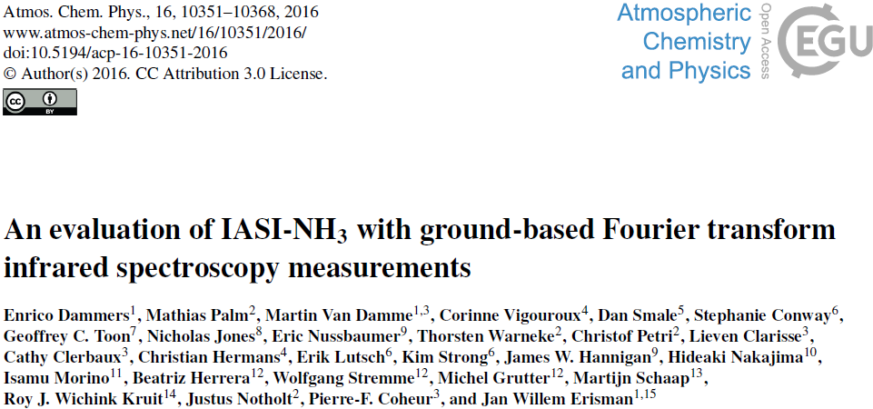
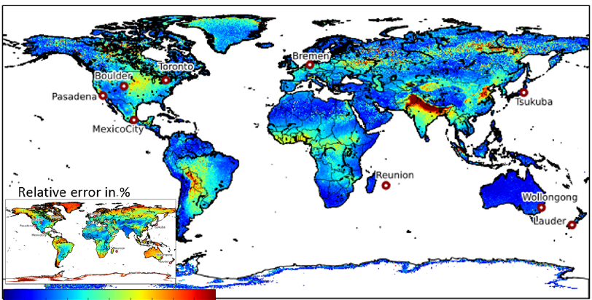
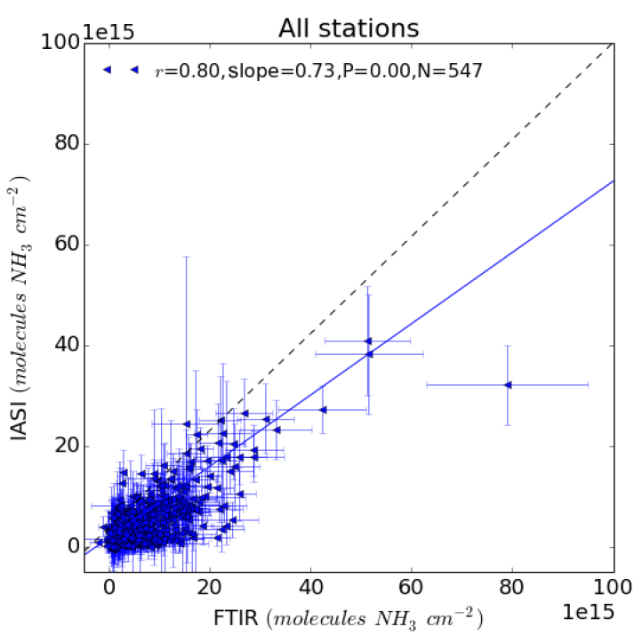
Analysis
FTIR measurements
9 locations
N_obs: 547
MRD (Mean Relative Difference): -32.4 ± (56.3) %
Correlation: 0.8
Slope: 0.73

Slide 4
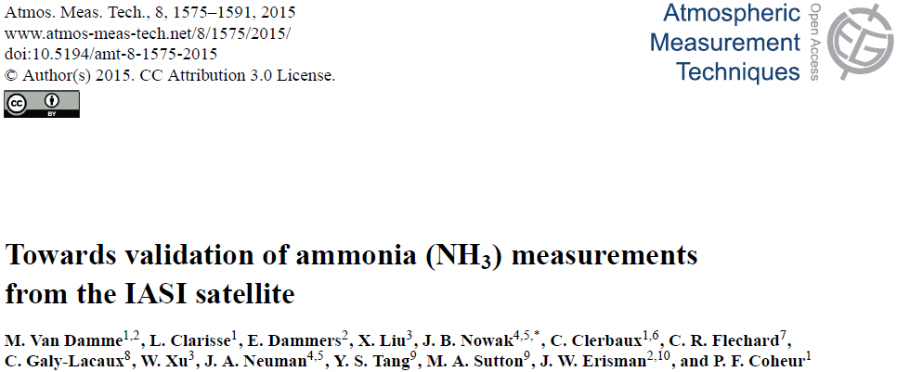
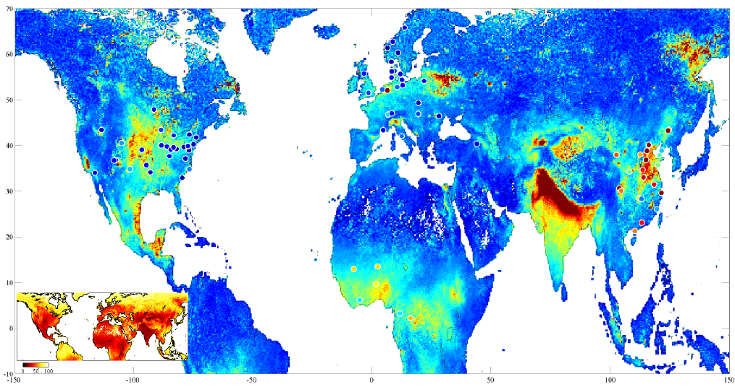
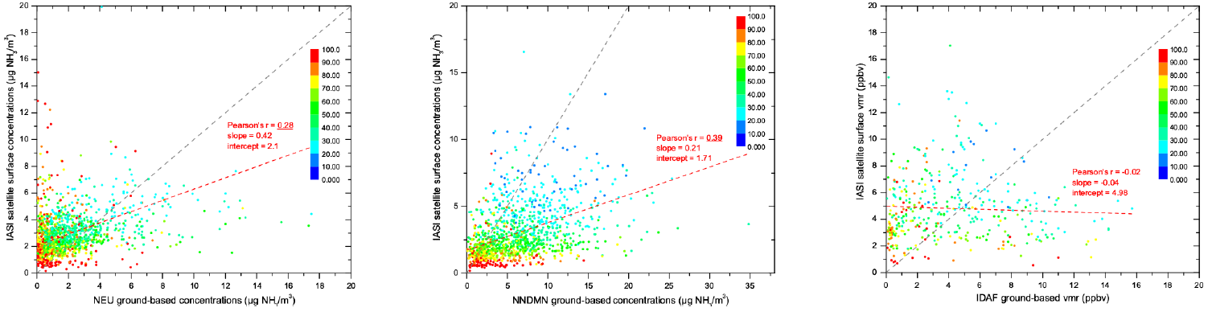
Analysis
Surface measurements
6 networks
Slope: low
Intercept: high
Airborne observations
Correlation: 0.8
retrieval error < 100%
mistime < 3h

Slide 5
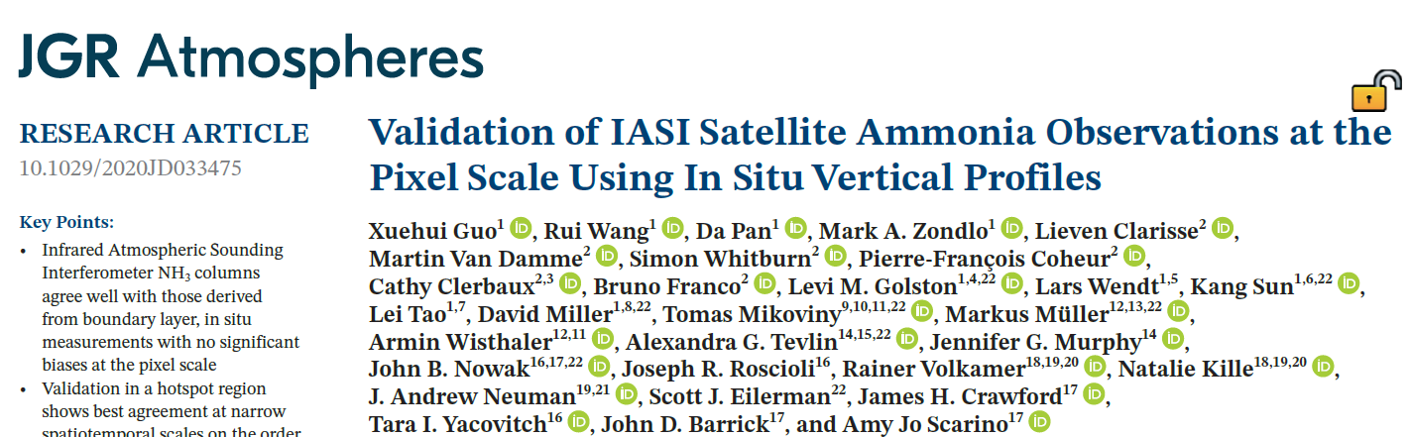
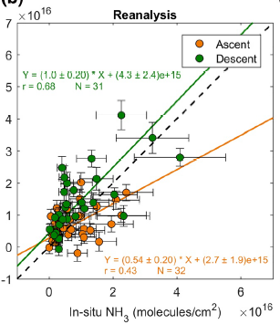
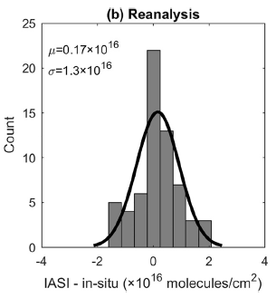
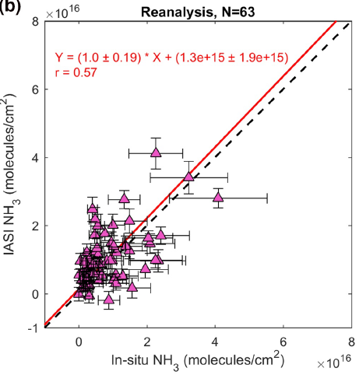
Analysis
In Situ Measurements
California (2013)
Colorado (2014)
Mean deviation: 0.17 E16 molecules/cm2
Standard deviation: 1.3 E16 molecules/cm2
Slope: 1±0.2
Correlation: 0.57

Slide 6
Plan
Comparison of NH3 emissions with other published results
Top down
Bottom up

Slide 7
litreature

Slide 8
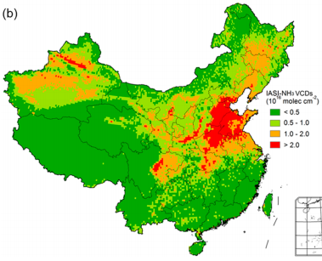
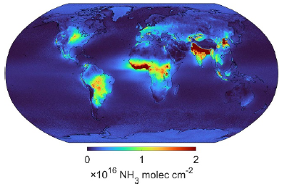

Global, regional and national trends of NH3, 2008-2018
Source
agricultural activities——major source (over 80% in Asia, Europe, US)
Livestock manure——volatilization
Synthetic fertilizer application——loss
EDGAR: 49 Tg
Agricultural: 86%
20 % increase over 2000-2010
GFED:
Others: 4.9 Tg
Reduction in emissions of nitrogen and sulfur oxides——increased NH3
Satellite measurements: morning overpass IASI/Metop-A——2008-2018
A good correlation: in-situ vertical profiles vs IASI-NH3
Trend method:
least squares regression
bootstrap resampling
global/national
(Zhang et al., 2017)
(Van Damme et al., 2021)
Notes:
https://doi.org/10.1088/1748-9326/abd5e0

Slide 9
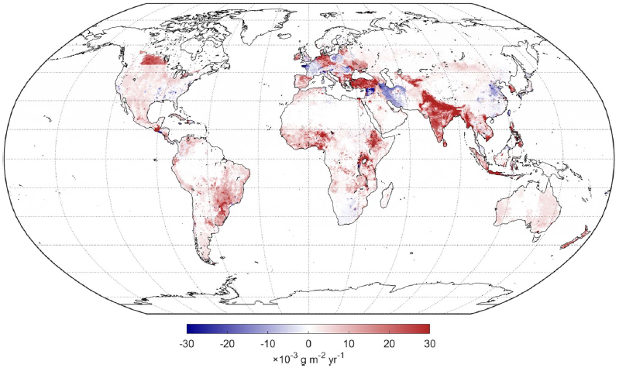
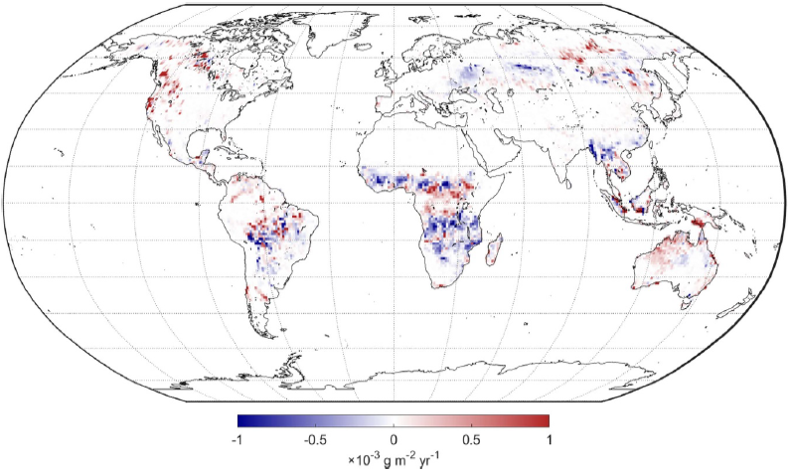
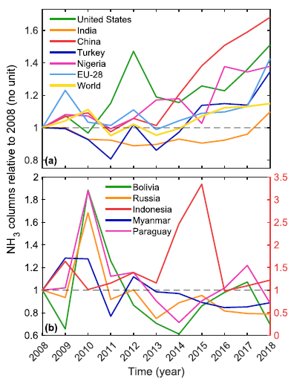
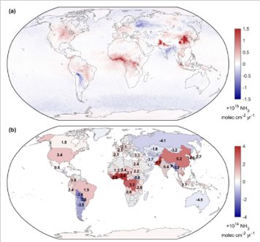
Global, regional and national trends of NH3, 2008-2018
Inventory Trend:
EDGAR: 2008-2015
China: a moderately slow decline
GFED: 2008-2018
southeastern Asia: decrease
IASI Trend:
East Asia: largest increase
China: 83.3 ± 7.0 %——longer atmospheric lifetime
India:
IGP: high upward
Southeastern: decreasing
EU: increase in 2018
Western and central Africa: strong upward
South America: small change
US: positive
(Van Damme et al., 2021)
Notes:
https://doi.org/10.1088/1748-9326/abd5e0

Slide 10
Questions?

